Slide 1

Eduzo
Presentation By:
Abhi Saxena (2105250109001)
Tanmay Singh (2005250100053)
Shresth Prakash Yadav (2005250100049)
Guided by:
Mr. Deepak Kumar
Department of Computer Science and Engineering
Buddha Institute of Technology, Gida, Gorakhpur
Notes:
Line spacing + Page numbers

Slide 2
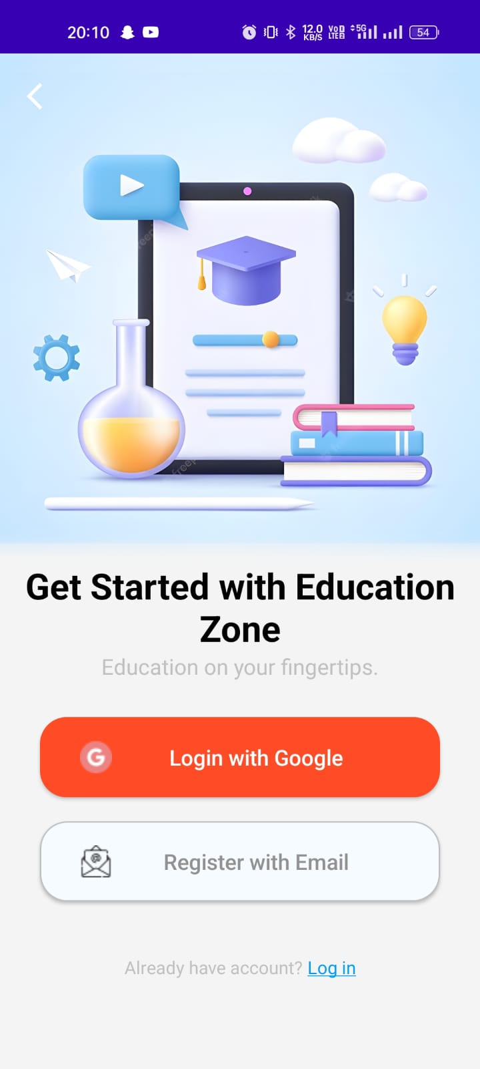
Content
INTRODUCTION
PROPOSED SYSTEM
WORKING
OBJECTIVE
TECHNOLOGY USED
RESULT
FUTURE SCOPE
CONCLUSION

Slide 3
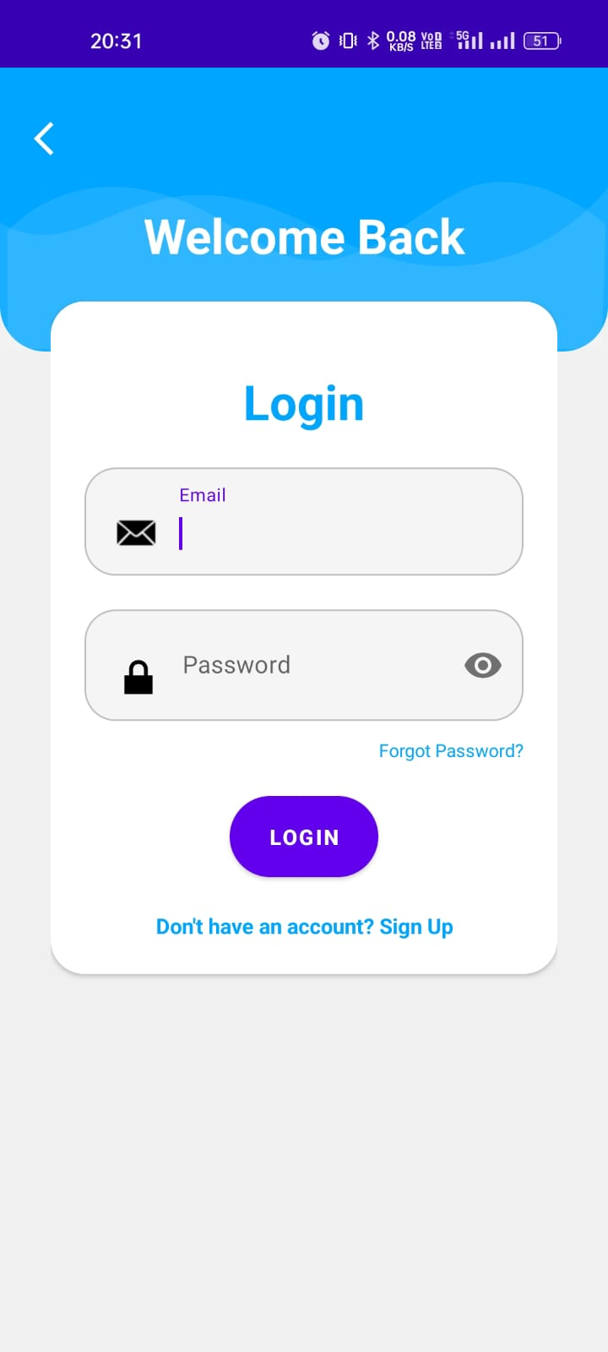
Introduction
Eduzo is an interactive quiz app designed to enhance learning through quizzes and educational challenges.
It offers a wide range of subjects and topics, catering to learners of all ages.
With its user-friendly interface and informative content, Eduzo aims to make learning enjoyable and accessible, promoting knowledge retention and growth.

Slide 4
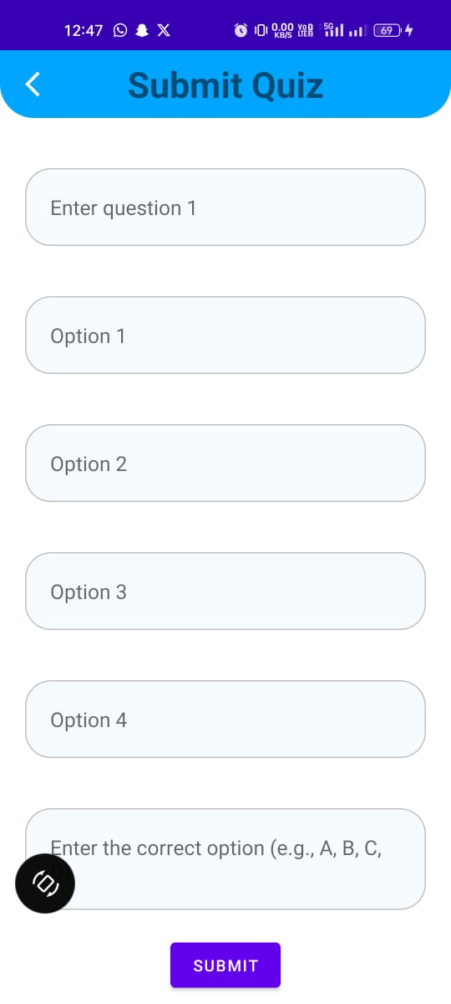
Proposed System
Introducing educational enhancement through quizzes.
Teachers can assess the students based on quiz questions and scores.
Student can themselves refer to their understanding level through attempting quizzes.

Slide 5
WORKING
LOGIN / SIGN UP
Login and sign up interface for teacher and students
SUBMIT QUIZ
Submit the quiz for teacher to access
ATTEMPT QUIZ
Attempt the quiz of respective subjects
VIEW SCORE
See the results and score

Slide 6
Objective
Education
Progress
Interaction
Assessment
Competition
Gamification

Slide 7
Technology Used
Android Studio is the official Integrated Development Environment (IDE) created by Google for designing, coding, and testing Android applications.
XML layout
JAVA
Firebase

Slide 8
RESULTS

Slide 9

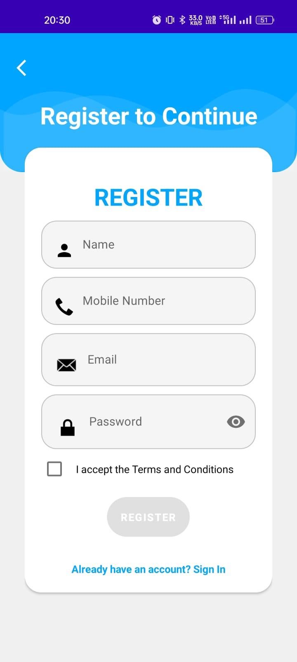
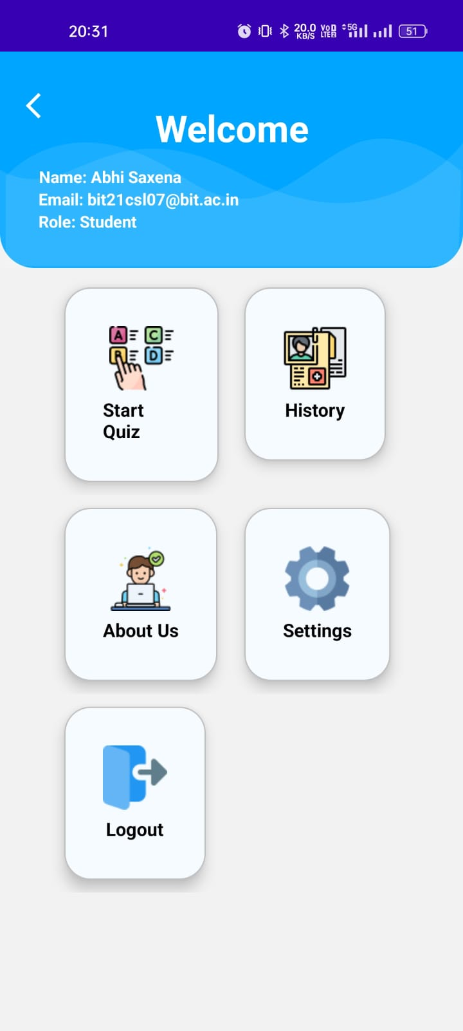
Screenshot

Slide 10
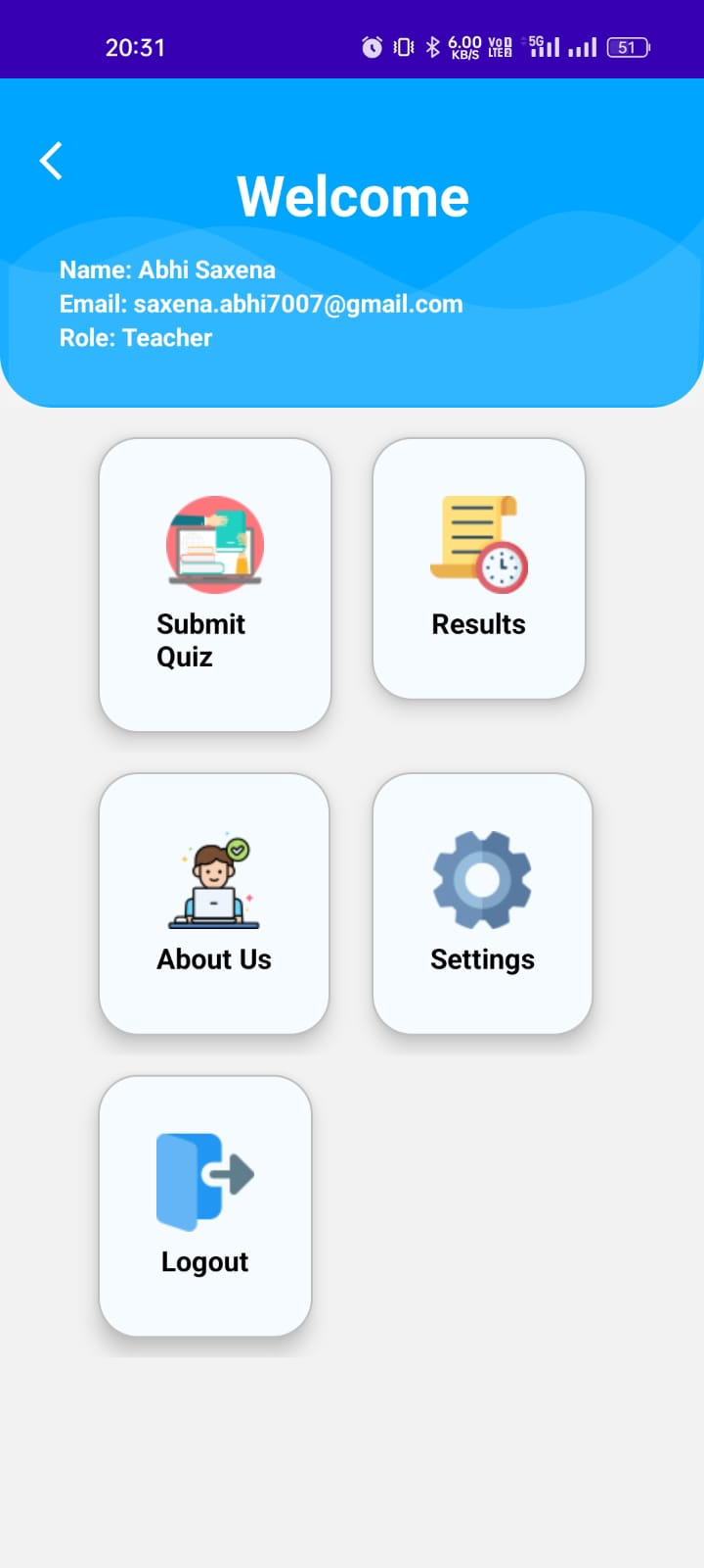
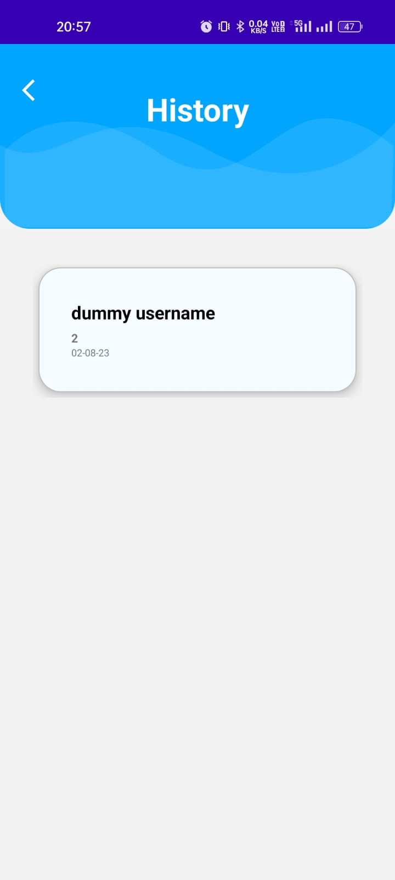
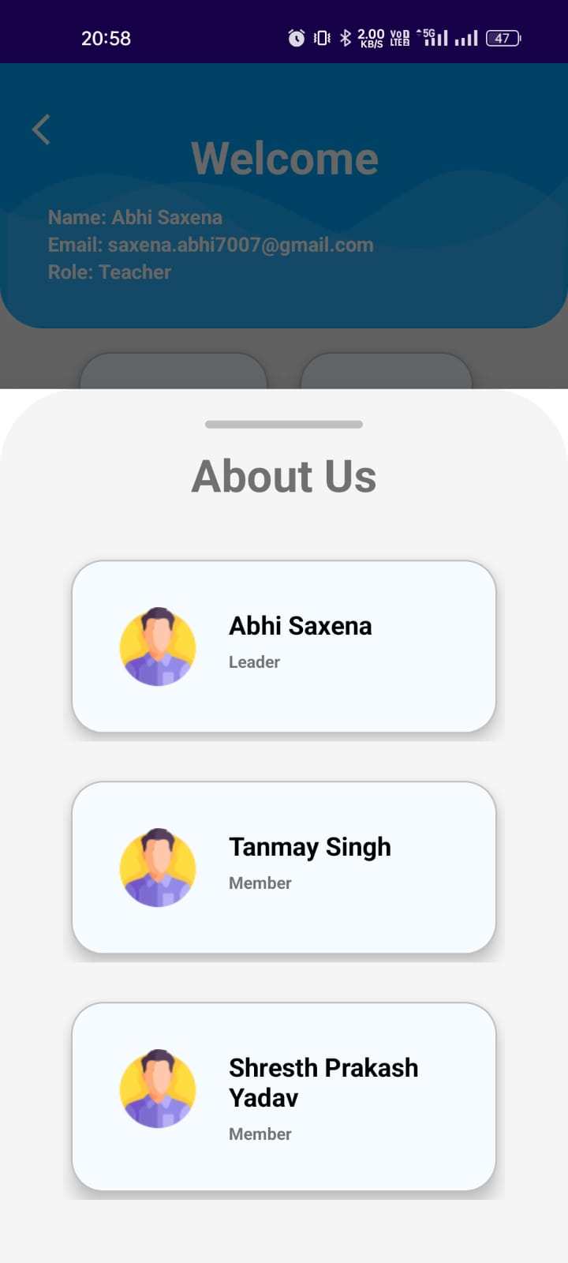
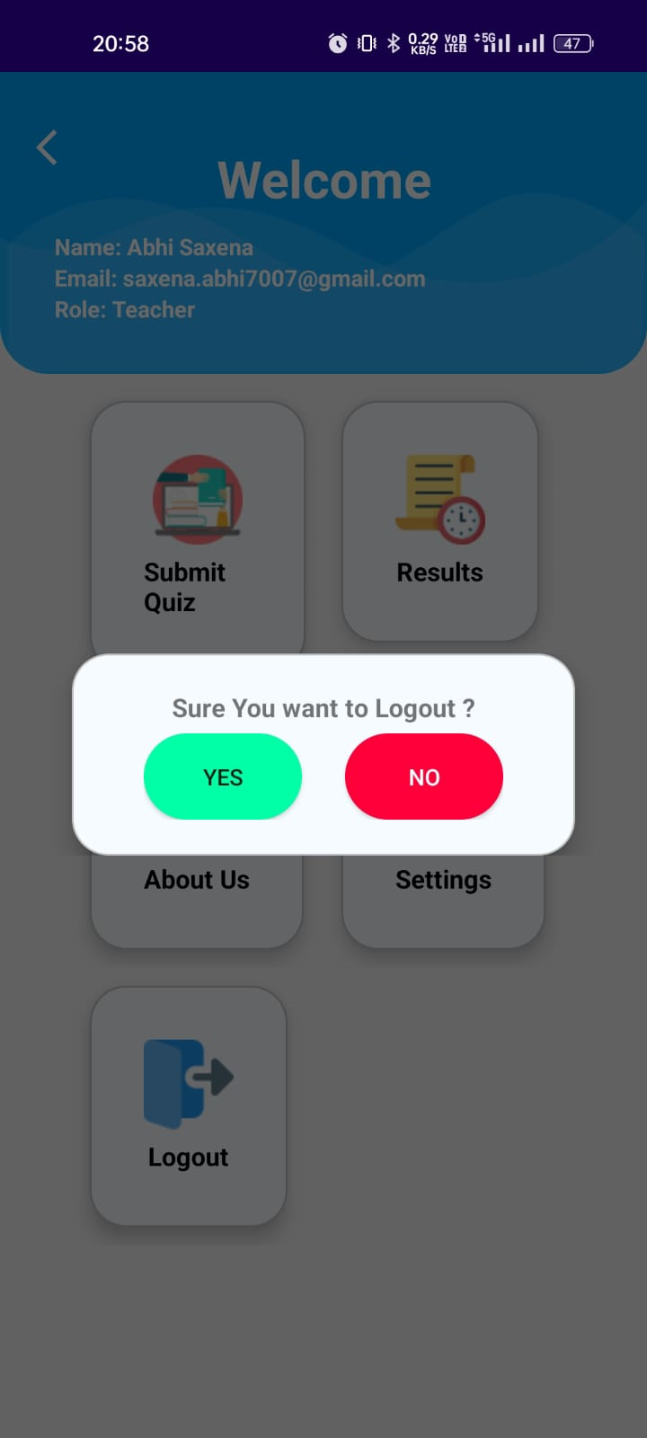
Continue…

Slide 11
Future Scope
Live Classes The Students can attend the Live Classes in the App. | Attendance Management Automatically Marking the attendance of the users.
Books and References Multiple Books and References for Studying. | Facial Monitoring Live monitoring during the quiz time session.
Time Management Better Time management through time tables and schedules. | Group Interaction Session Discussion and Live Doubt Sessions.

Slide 12

Conclusion
We commit proper flow of education through our Eduzo app which will provide student assisment through gamification of quizzes , as well as save teacher's time and resources
THANK YOU

